Slide 1
CISC 372 Final Project
By Joseph Chan

Slide 2
Introduction
“ESRB” Rating
Video Games
Kaggle Dataset

Slide 3
Models
Neural Network
XGBoost Classifier
Random Forest
Birch Clustering
K-Nearest Neighbour

Slide 4
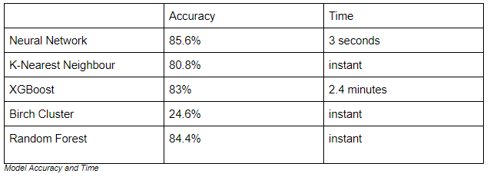
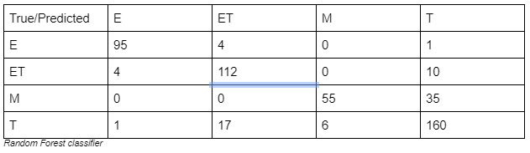
Results

Slide 5
Lessons Learned
Overfitting
Quality of Parameters
Voting Ensemble

Slide 6
Conclusion
Accuracy
Confusion Matrix
Best Model

